Slide 1
Project Presentation
Prepared by Group02
Tan Phat Nguyen
Minh Thiep Ha
Tuan Anh Nguyen
Thanh Trung Le
MPP Library Application

Slide 2
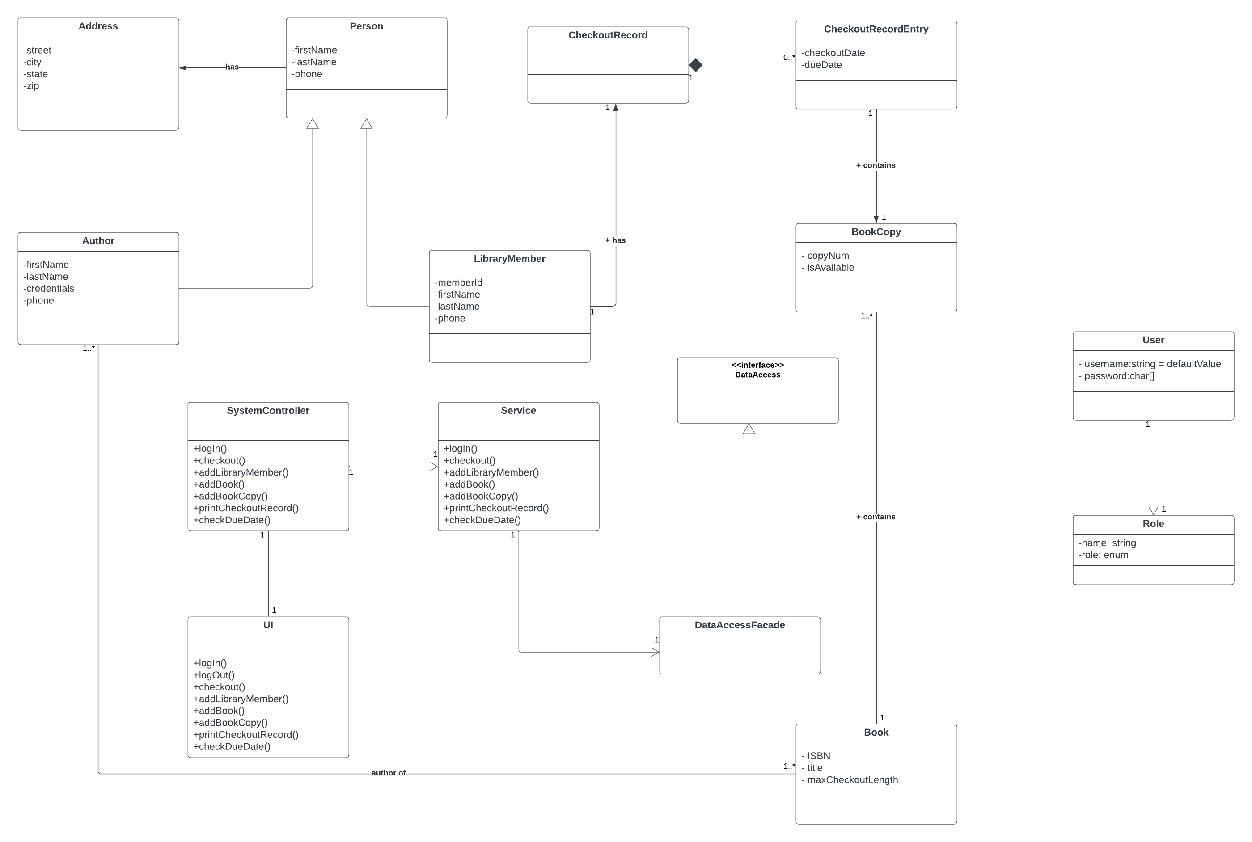
Class Diagram

Slide 3
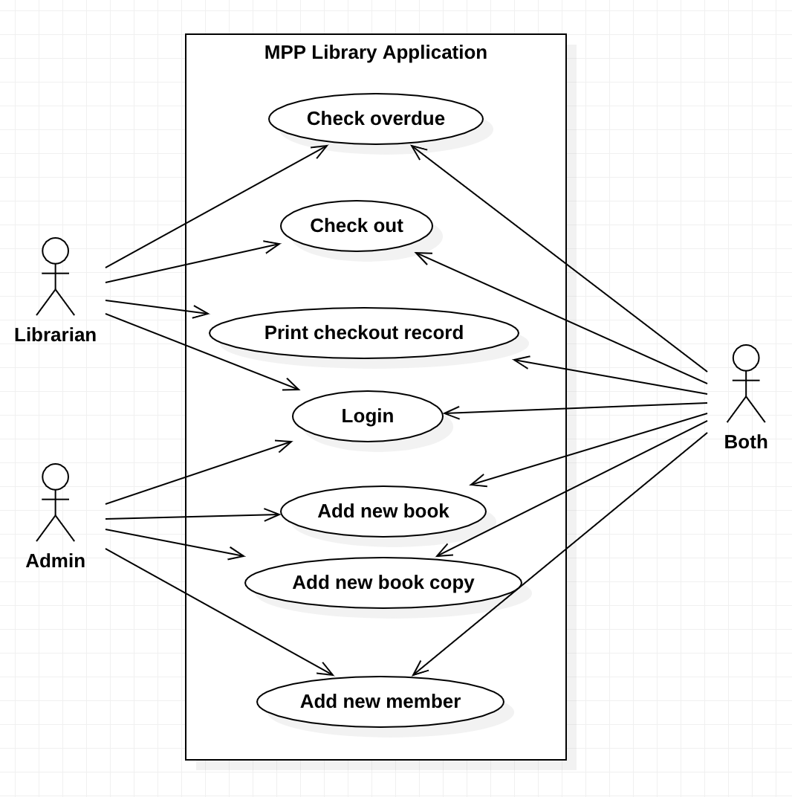
Use Case Diagram

Slide 4
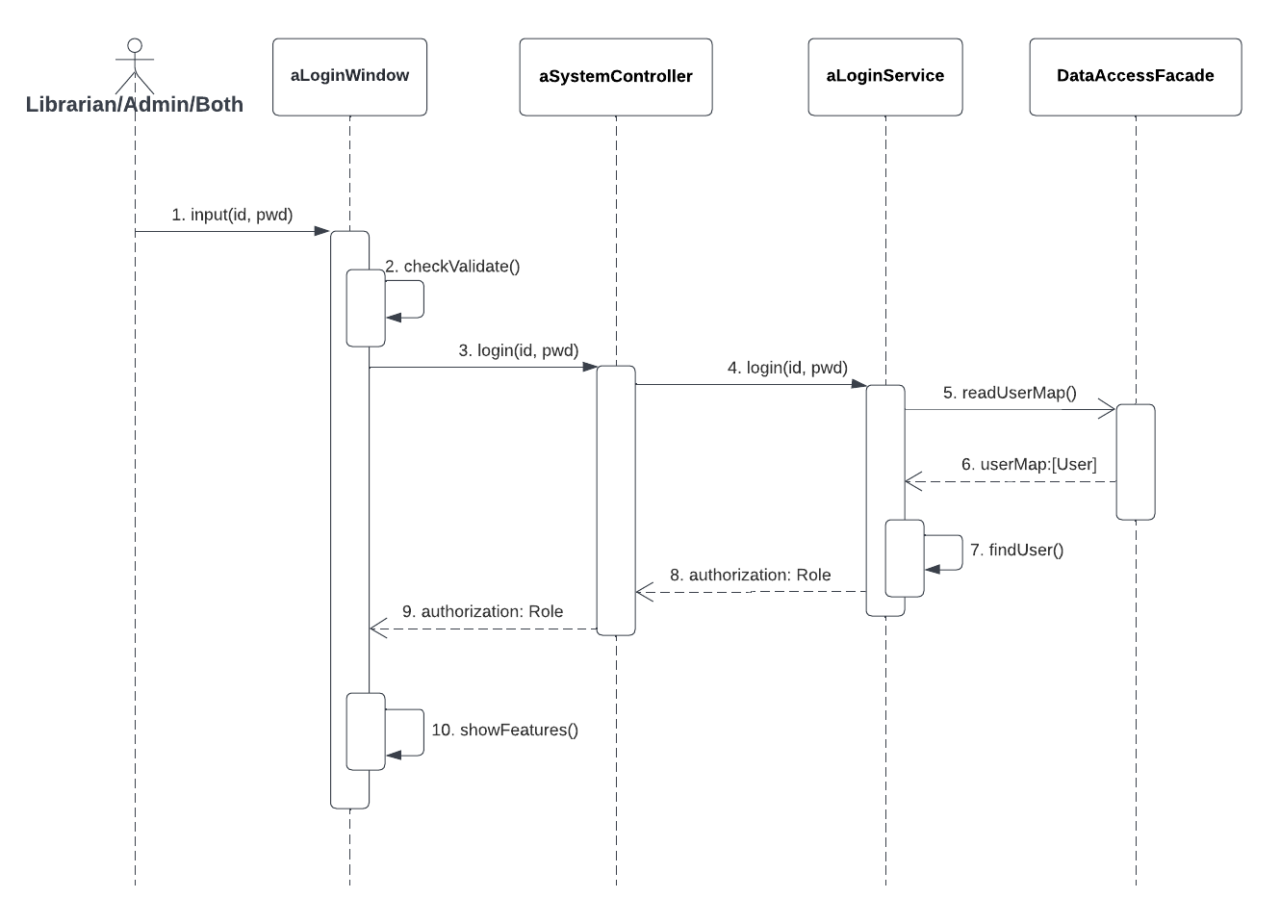
1. Login

Slide 5
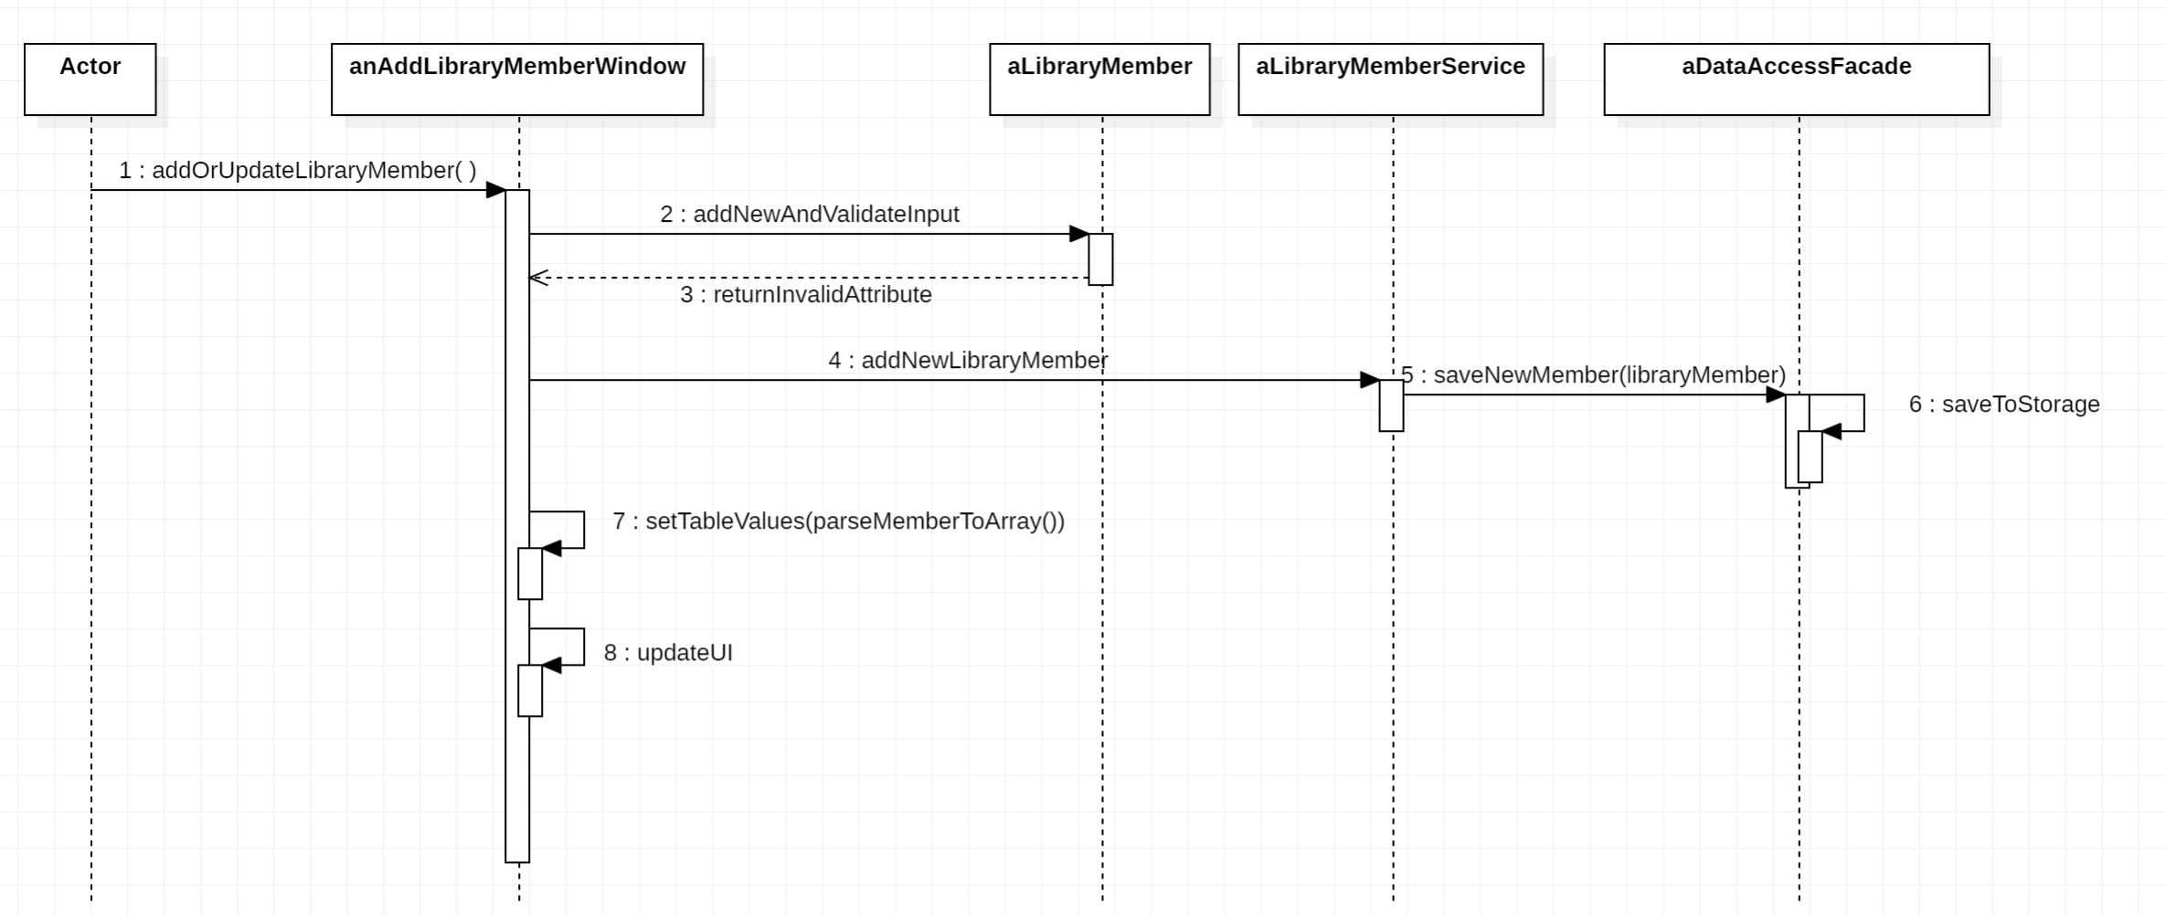
2. Add new library member

Slide 6
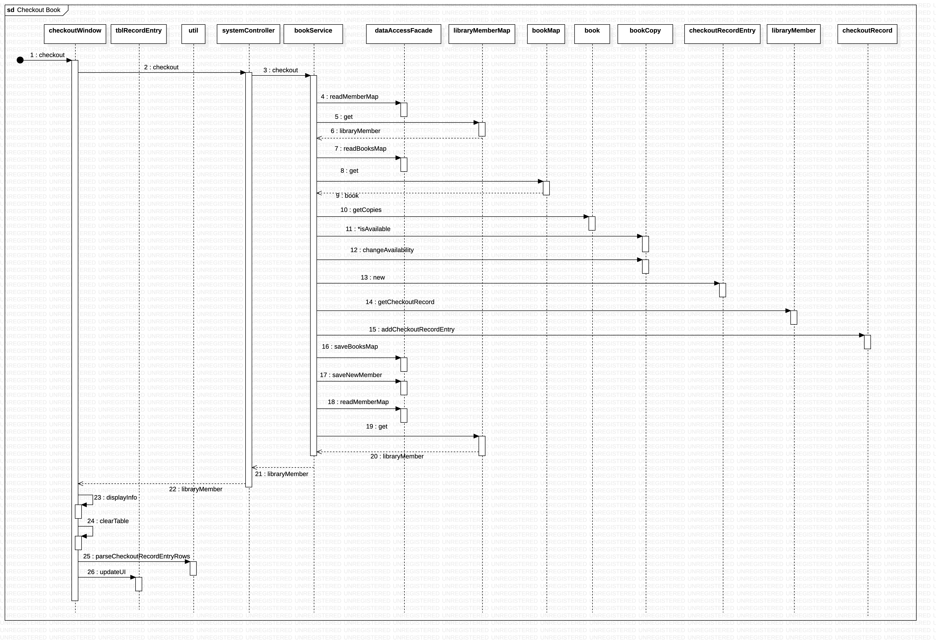
3. Checkout a book

Slide 7
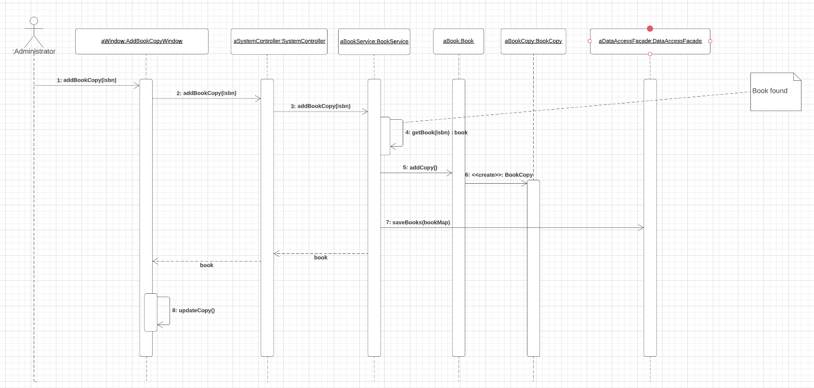
4. Add new book copy

Slide 8
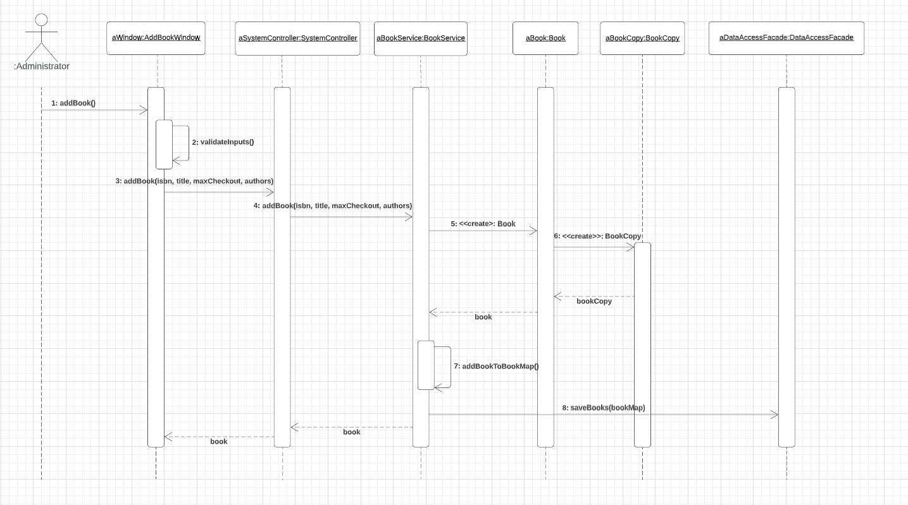
5. Add new book

Slide 9
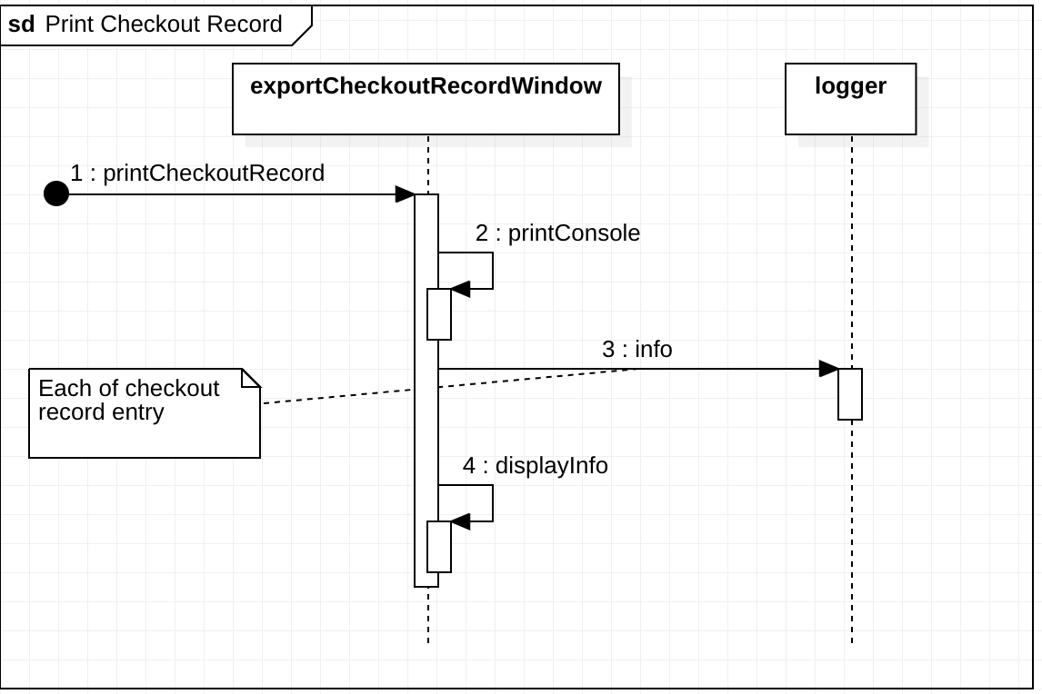
6. Print checkout record

Slide 10
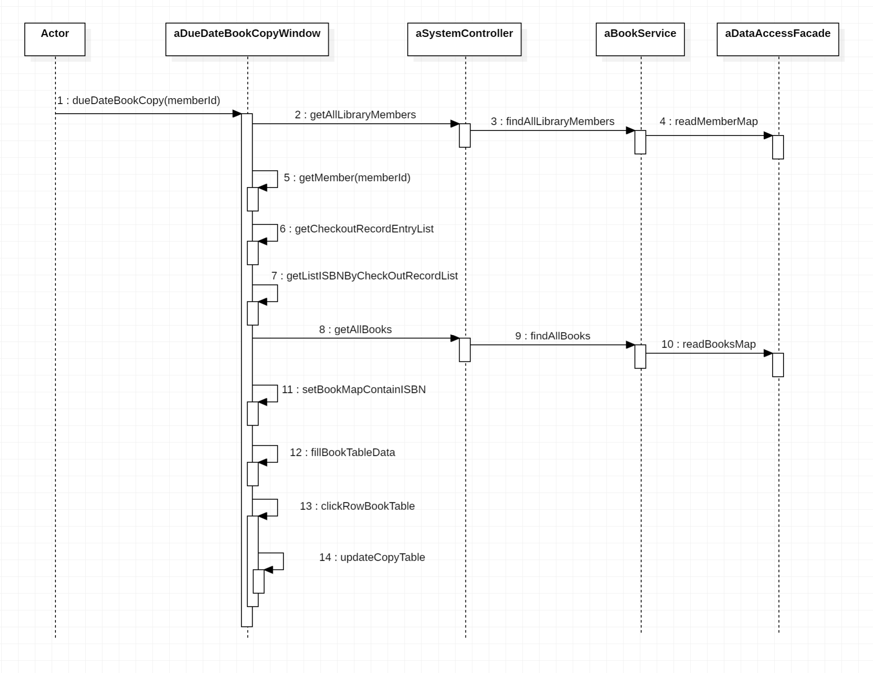
7. Check overdue record

Slide 11

THANK YOU!
ANY QUESTIONS?

